Slide 1
Lecture Five Vacuum Molding
Uses sand mold held together by vacuum pressure rather than by a chemical binder
The term "vacuum" refers to mold making rather than casting operation itself
Developed in Japan around 1970

Slide 2
Vacuum Molding: Advantages and Disadvantages
Advantages:
Easy recovery of the sand, since no binders
Sand does not require mechanical reconditioning done when binders are used
Since no water is mixed with sand, moisture‑related defects are avoided
Disadvantages:
Slow process
Not readily adaptable to mechanization

Slide 3
Expanded Polystyrene Process
Uses a mold of sand packed around a polystyrene foam pattern which vaporizes when molten metal is poured into mold
Other names: lost‑foam process, lost pattern process, evaporative‑foam process, and full‑mold process
Polystyrene foam pattern includes sprue, risers, gating system, and internal cores (if needed)
Mold does not have to be opened into cope and drag sections

Slide 4
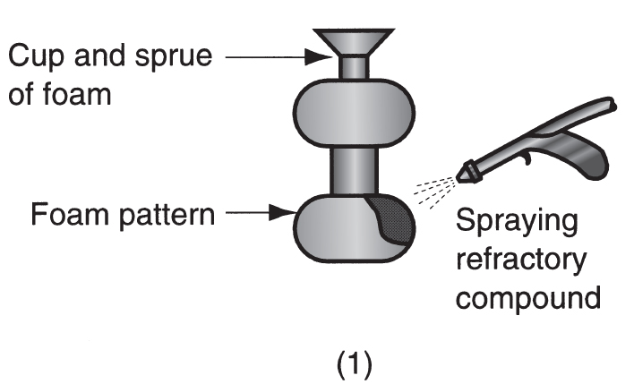
Steps in Expanded Polystyrene Process
(1) Polystyrene foam pattern is coated with refractory compound

Slide 5
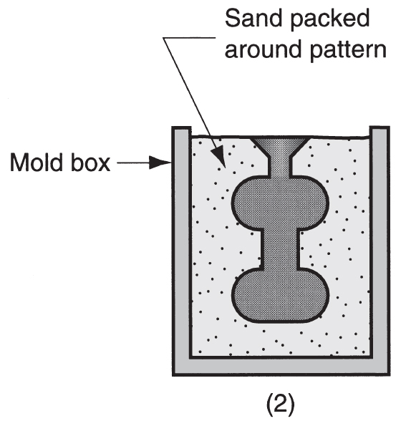
Steps in Expanded Polystyrene Process
(2) Foam pattern is placed in mold box, and sand is compacted around the pattern

Slide 6
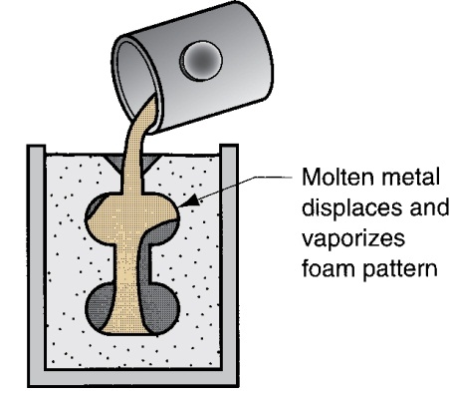
Steps in Expanded Polystyrene Process
(3) Molten metal is poured into the portion of the pattern that forms the pouring cup and sprue
As the metal enters the mold, the polystyrene foam is vaporized ahead of the advancing liquid, thus filling the mold cavity

